Slide 1

Predicting an Option contracts price
Capstone Project
Data Analytics Boot Camp
The University of Miami
E. Deutsch | D. Perez

Slide 2
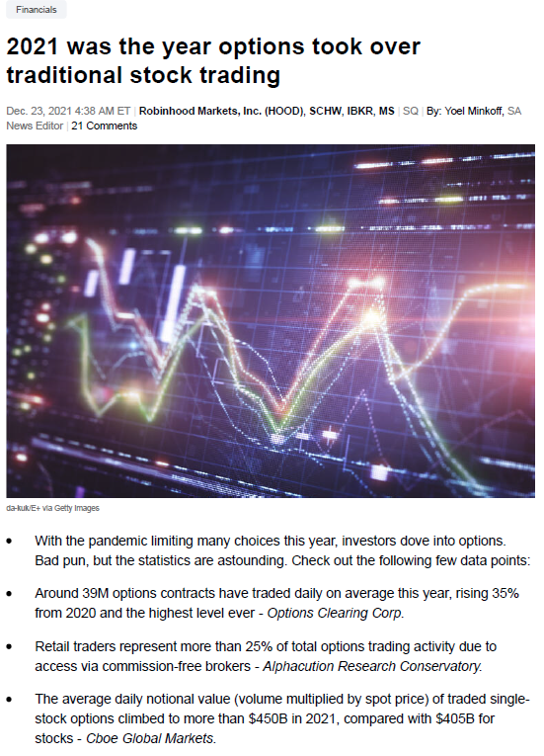
Why this topic?
We have a background in the field of finance
There are an abundance of opportunities in the derivatives market
Data analysis is essential in today’s world, this sector has many opportunities for this
An excellent challenge to apply what we have learned

Slide 3
Overview
Questions we hope to answer with the data
Environment and setup
Description of source data
Pre-Processing
Train/Test/Split
Machine Learning
Post-Processing
Results/Visualization
Recommendation for future analysis

Slide 4

Questions to answer
What is the Predicted Price for each DOW30 stock option contract?
What could we have done differently to get better results?
What do we recommend for future analysis?

Slide 5
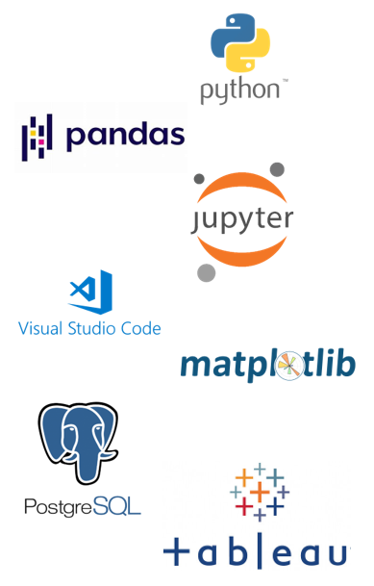
Environment and Setup
Python
Pandas
Jupyter Notebooks
VS Code
Matplotlib
PostgreSQL
Tableau

Slide 6
Environment and Setup
To set up the development environment create a new environment referencing the environment_requirement.txt file.
To obtain the requirement list we used
>pip freeze >requirements.txt

Slide 7
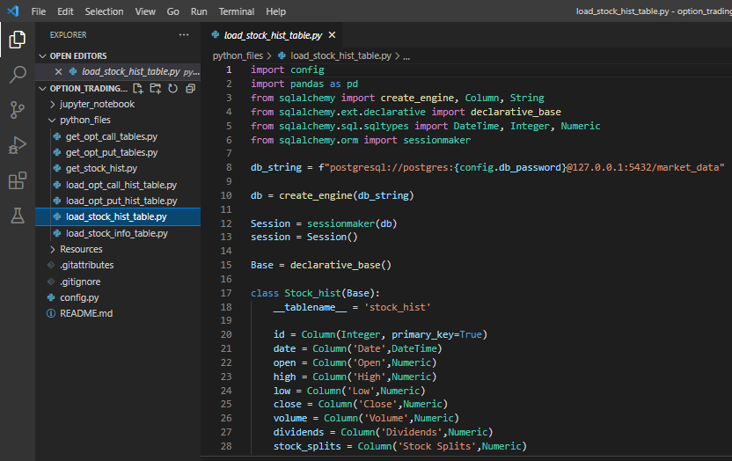
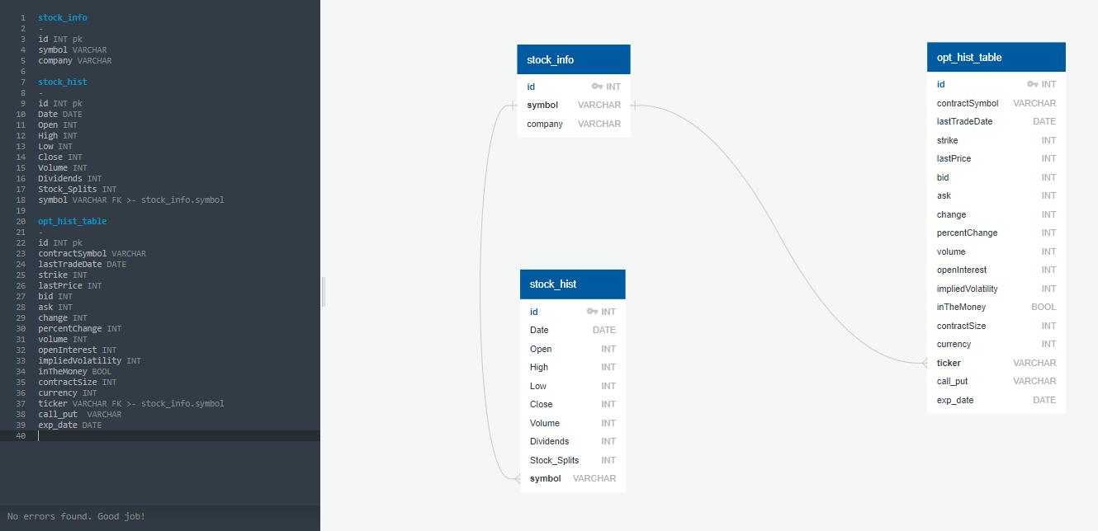
PostgreSQL Database
Loaded .csv into three PostgreSQL tables "stock_info", "stock_hist", "opt_hist_table“
DB Schema
Sqlalchemy to postgresQL

Slide 8
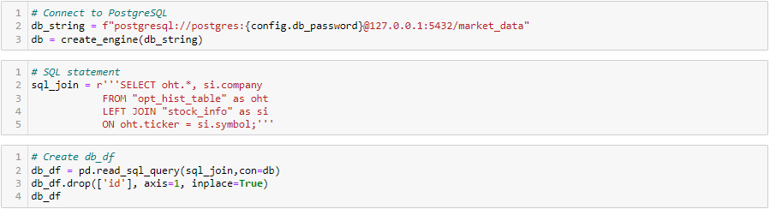
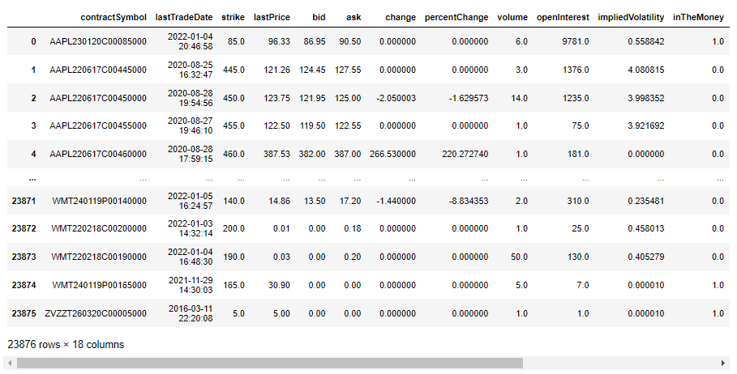
PostgreSQL – Python
Used Pandas query the PostgreSQL database for a total of 23,876 rows and 18 columns.
Objective is to predict the contract price within the stocks of the DOW30.

Slide 9
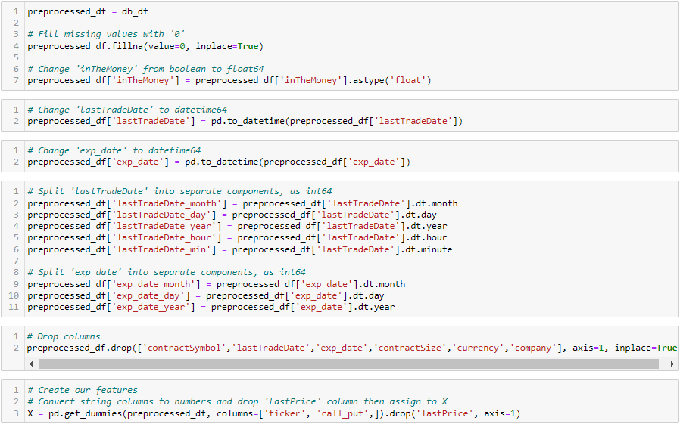
Pre-Processing
Cleaned data to prepare for split/test/train

Slide 10
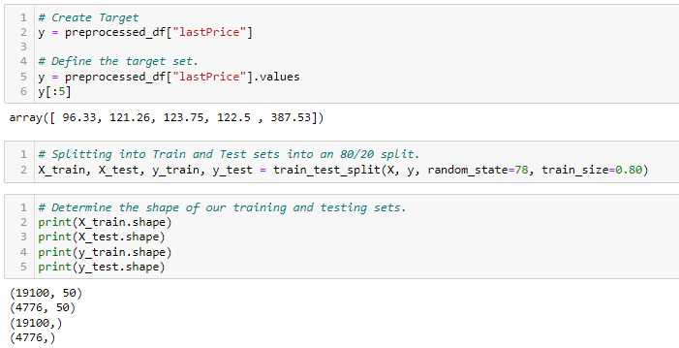
Train/Test/Split
The loaded dataset is split into input and output components
Split the dataset so that 80% is used to train and 20% is used to evaluate.
Evaluate the shape of our training and testing sets.

Slide 11
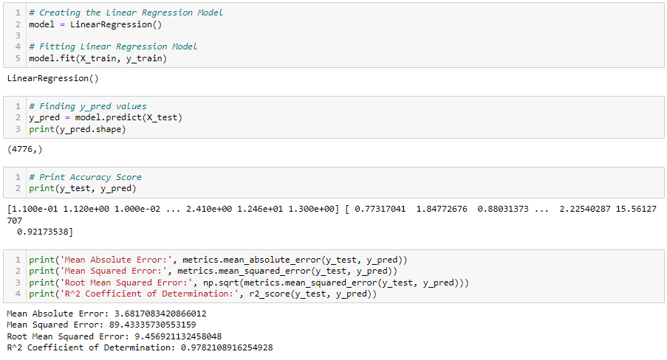
Machine Learning
Linear regression analysis rests on the assumption that the dependent variable (y) is continuous. This makes Linear Regression Modeling the preferred method for price prediction.

Slide 12
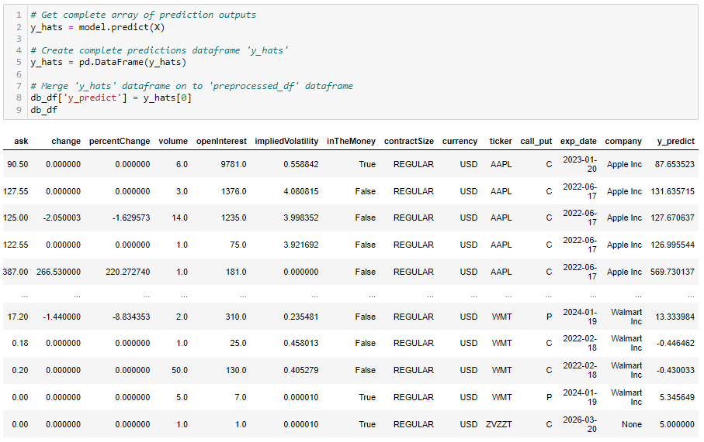
Post-Processing
After reviewing the results of our linear regression model and predicted values we merged the outputs to the original dataset.

Slide 13
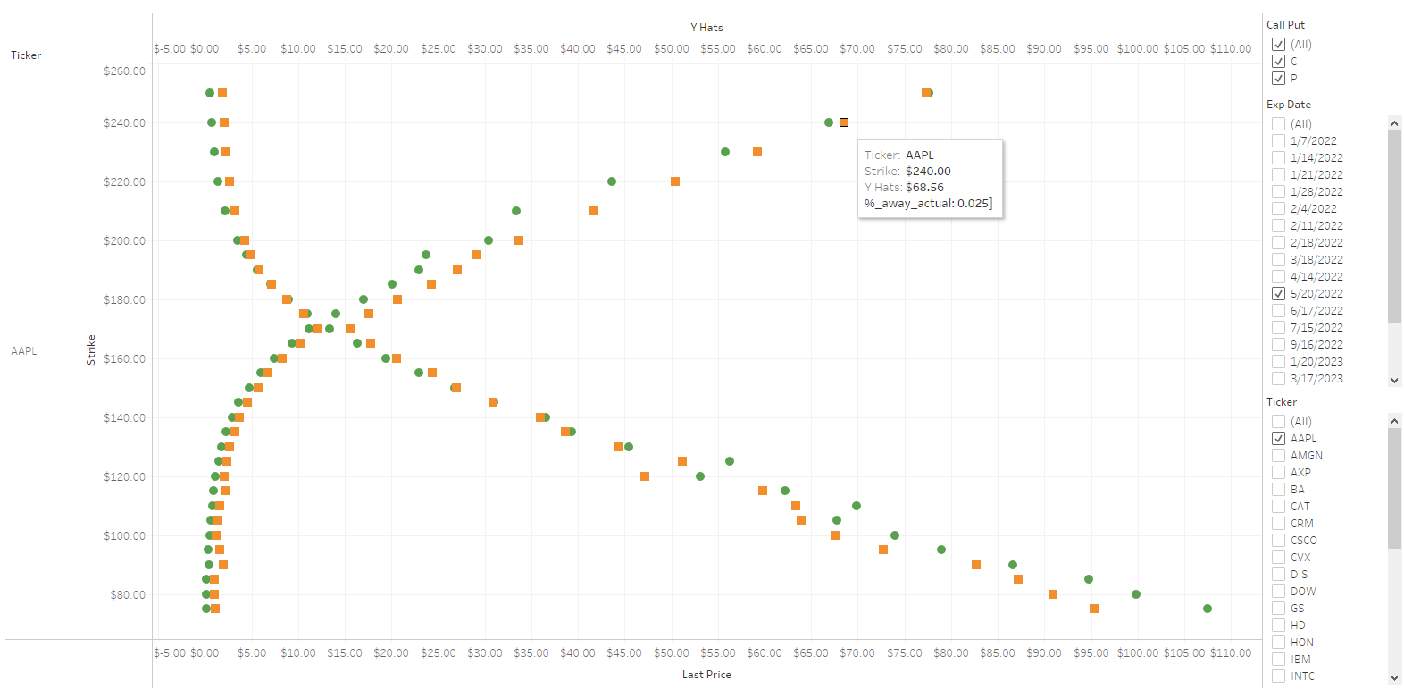
Results/Visualization
https://public.tableau.com/views/Option_Trading_ML_TableauStory/Presentation?:language=en-US&publish=yes&:display_count=n&:origin=viz_share_link

Slide 14
Recommendation for future analysis
For future analysis other machine learning models such as:
Decision Tree
RandomForest
Add additional features:
Yield Curve Plots
Implement greeks (delta, gamma, theta, vega)
Changing from static to time-series modeling.

